Slide 1
Natural Language Processing (NLP)

Slide 2
Natural Language Processing (NLP)
Regular Expressions
N-gram Language Model
Naive Bayes and Semantic Classification
Vector Semantics

Slide 3
Logistic Regression

Slide 4
Logistic Regression
Supervised Machine Learning algorithm for binary classification.
Predicts the probability that a given input belongs to a particular class (spam vs no spam, positive vs negative)
It uses sigmoid function to map predicted values to probabilities between 0 and 1
In NLP Logistic Regression is used for
  Text classification (spam, sentiment analysis)
  Language identification
  Intent classification
  Named Entity Recognition (as part of sequence classification)

Slide 5
Logistic Regression
NLP tasks require converting text into numeric feature using techniques like
  Bag of Words (BoW)
  TF-IDF
  Word embeddings (Word2Vec, Glove)

Slide 6
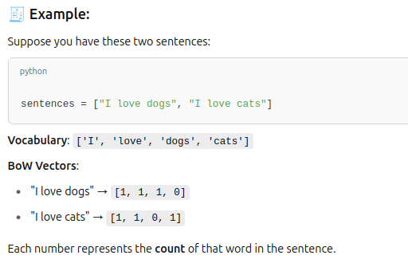
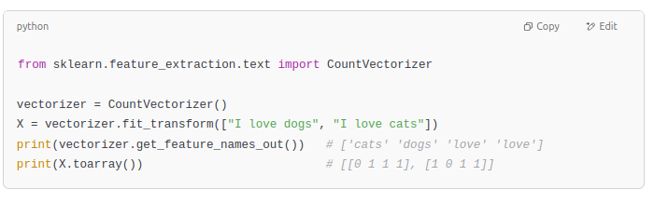
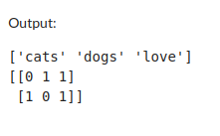

BoW
Bag of Words (BoW)
  Represents text by word occurrence counts.
  Ignore grammar, word order, context

Slide 7
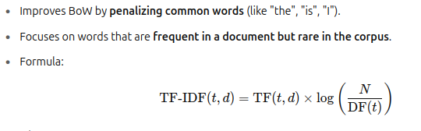
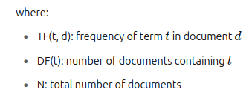
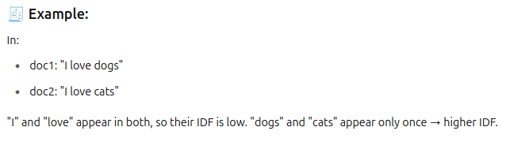
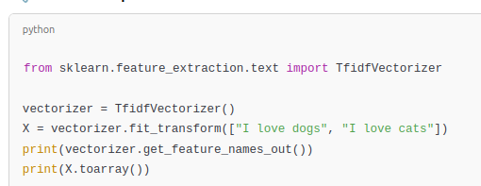
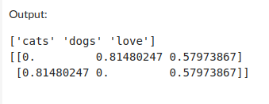
TF-IDF (Term Frequency-Inverse Document Frequency)

Slide 8
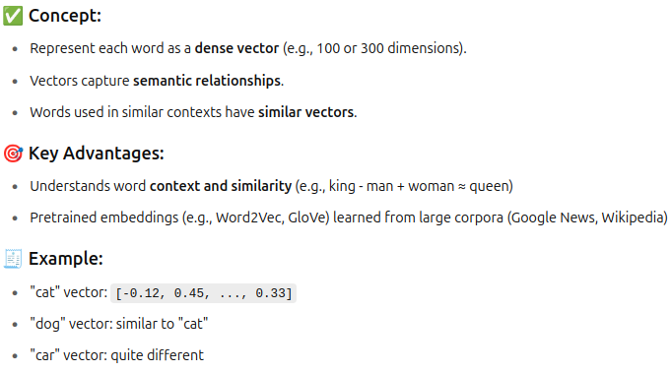
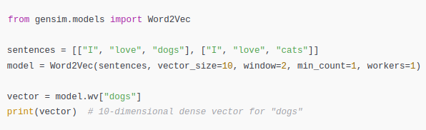
Word Embeddings (Word2Vec, GloVe)

Slide 9
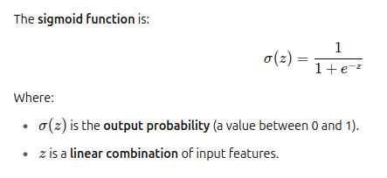
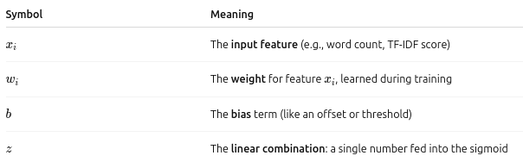
Logistic Regression
Sigmoid function is as follows
z=w1​x1​+w2​x2​+⋯+wn​xn​+b ?

Slide 10
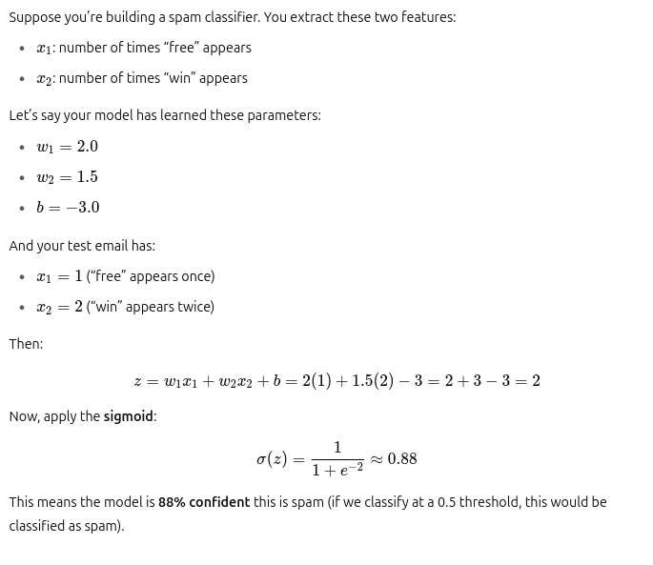
Logistic Regression - Example

Slide 11
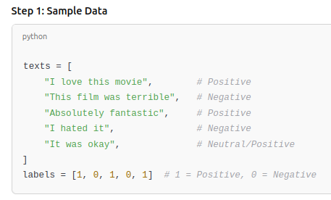
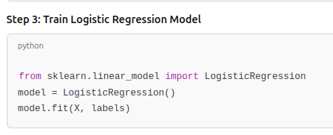
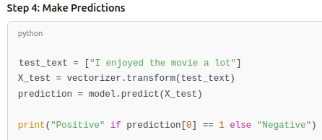
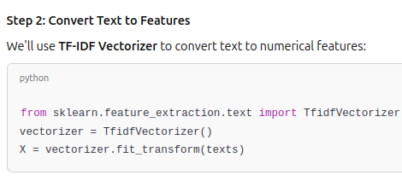
Logistic Regression - Example

Slide 12
Neural Networks and Neural
Language Models

Slide 13
Neural Networks
A neural network is a machine learning model inspired by the human brain. It's made up of layers of interconnected "neurons", which learn to recognize patterns in data.
Key Components:
  Input Layer: Receives raw features (e.g., text vector).
  Hidden Layers: Perform computations with weights and activation functions (e.g., ReLU).
  Output Layer: Produces the final prediction (e.g., class probabilities).

Slide 14
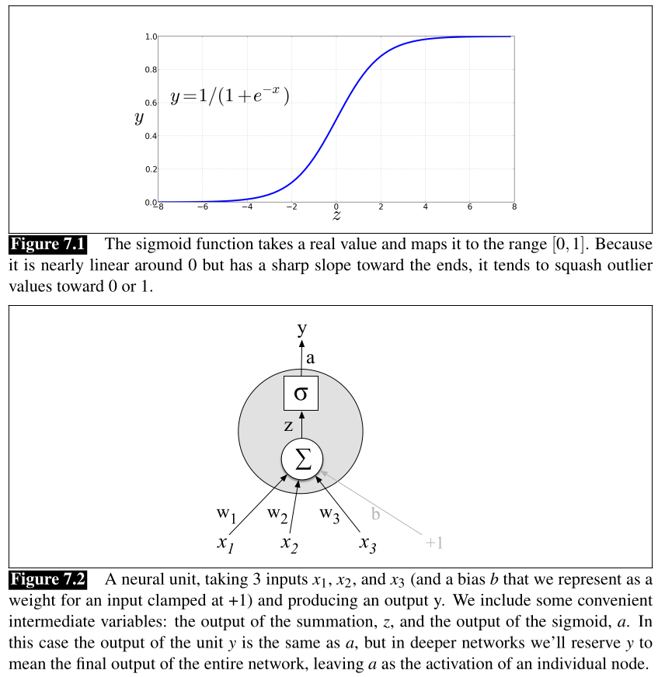


Neural Networks

Slide 15
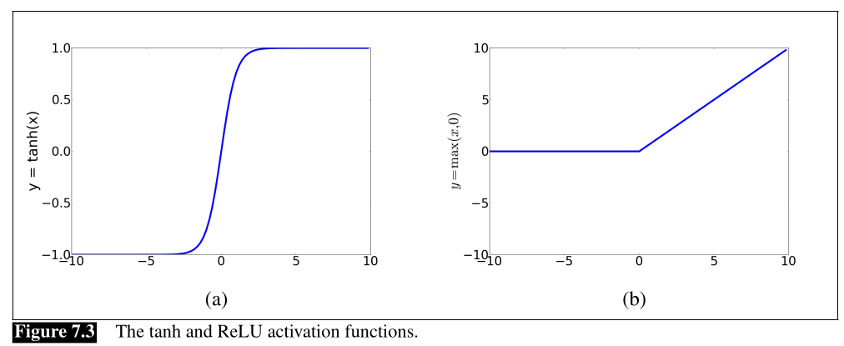
Neural Networks

Slide 16
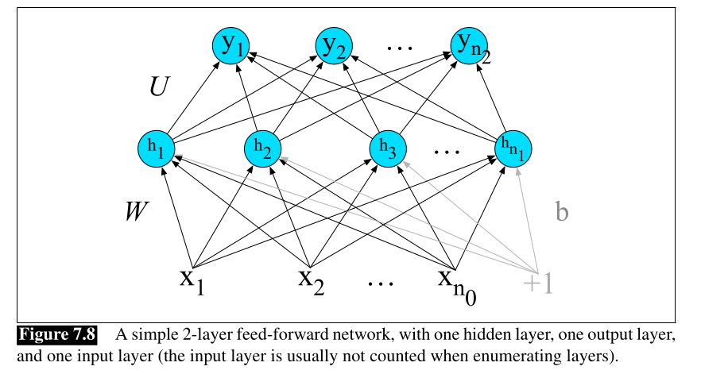
Neural Networks

